Slide 1
Artists and Art in the
Gig Economy
Amy Fletcher
Knoxville Arts Alliance
January 24, 2019
Contact: amyfletcher@protonmail.com

Slide 2
Presentation
Introductions
Overview of artists in the gig economy: key themes
Overview of digital platforms, tools, and opportunities
Some lessons (personal) learned
Example: Amy’s Personal Platform

Slide 3
Me
Associate Professor at University of Canterbury (NZ)
  Public speaking
  Consultancy – working with organizations on disruptive change and strategy
  Foresight practitioner
    (University of Houston, Jan 2019, Certificate in Professional Foresight)

Slide 4
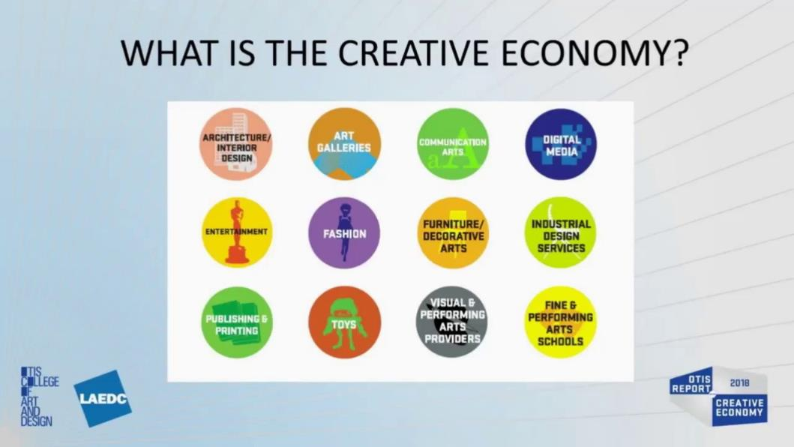

Slide 5
Overview of new technologies and the Gig Economy
New technologies and the art sector

Slide 6
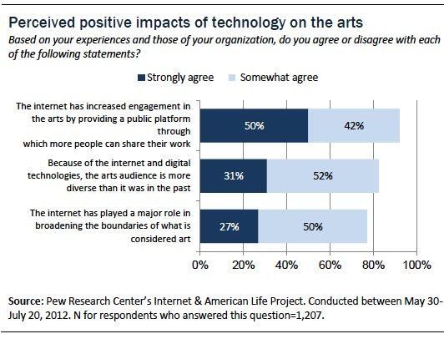

Slide 7
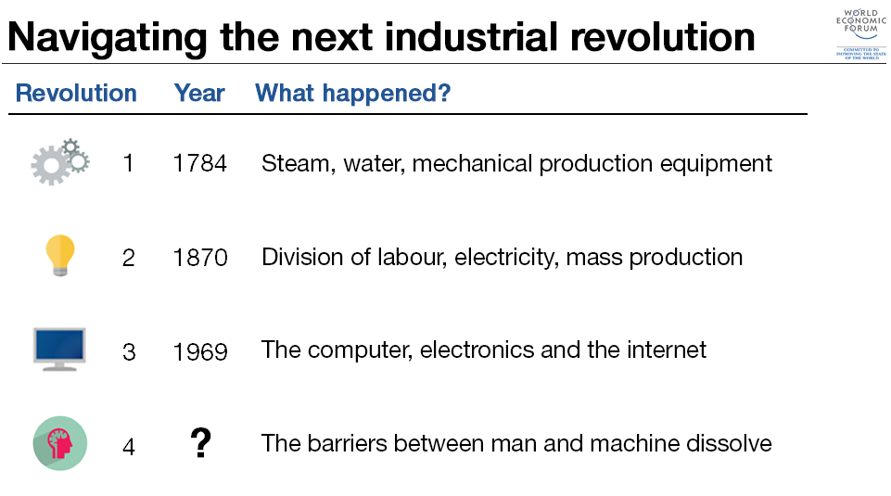

Slide 8
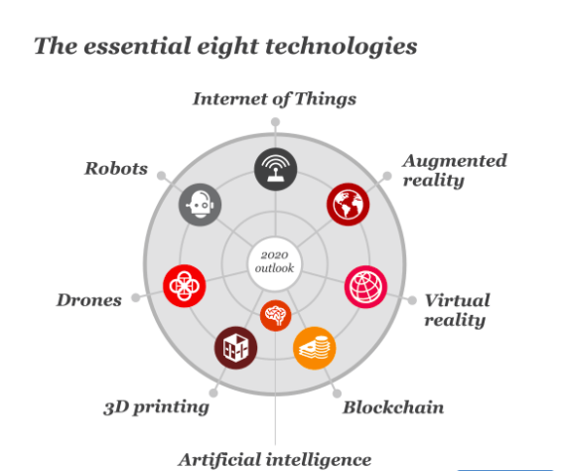

Slide 9
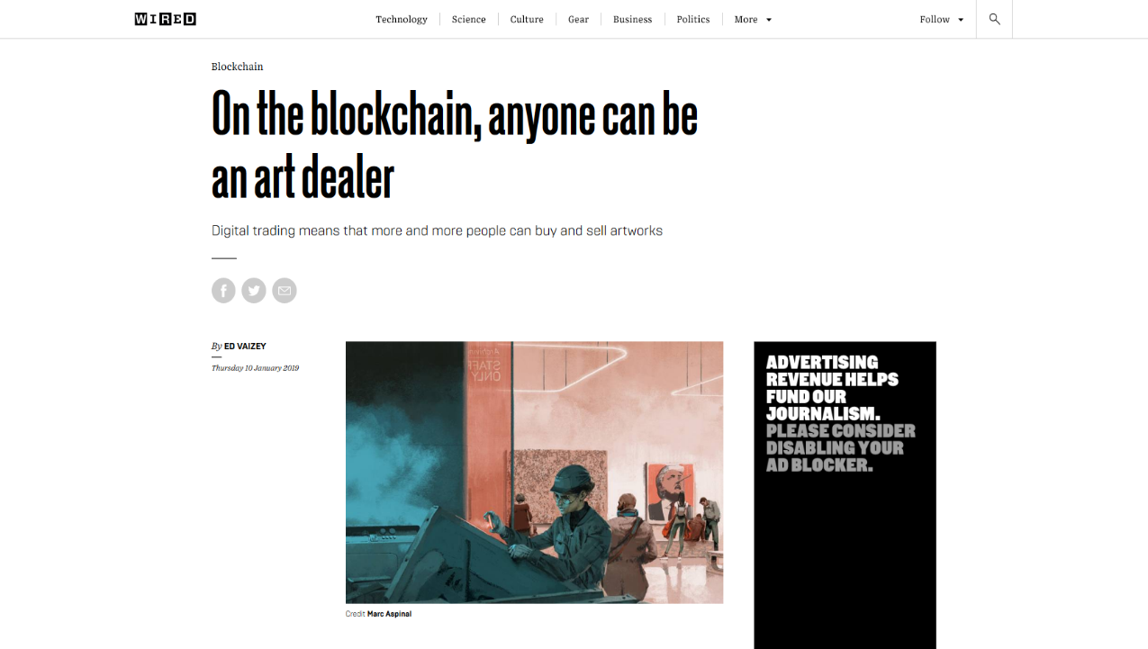

Slide 10
Promises of Blockchain
1. Driving digital art sales through digital scarcity
2. Democratizing fine art investment
3. Improving provenance and reducing art forgery
4. Creating a more ethical way of paying artists

Slide 11
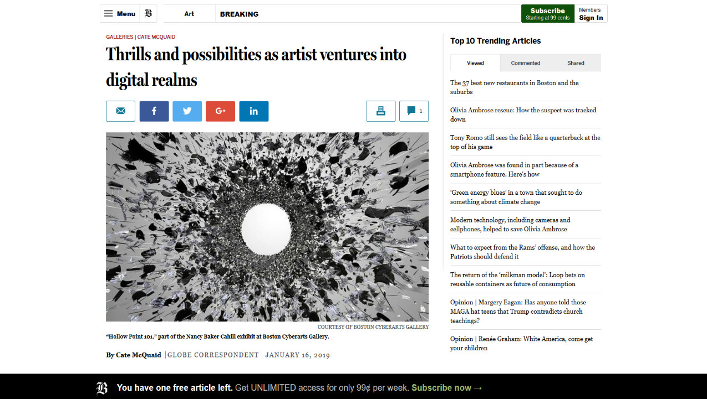

Slide 12
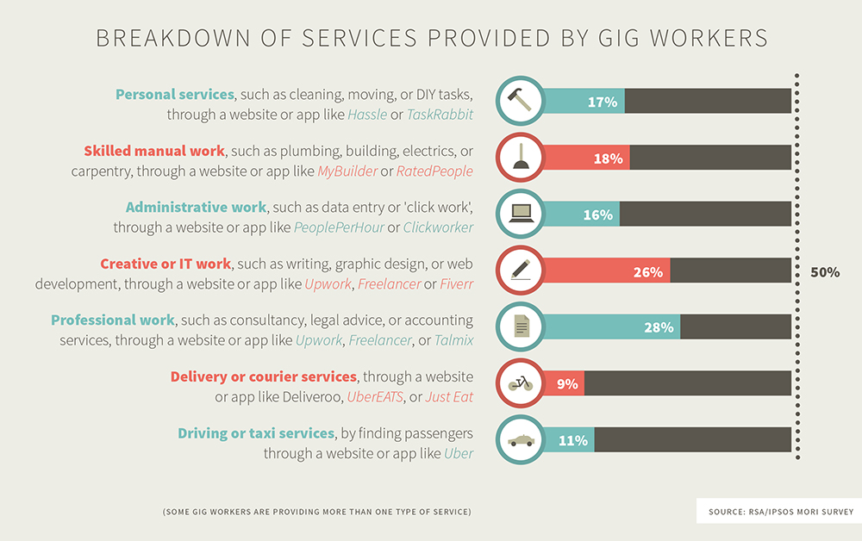

Slide 13
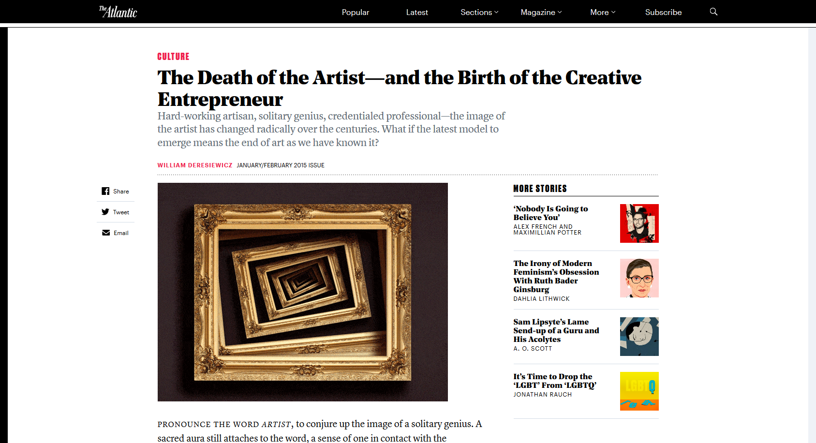

Slide 14
Paul Pacifico. CEO of the Association of Independent Music (AIM)
Artists today are pretty much by definition music entrepreneurs and owner-operated companies, building their businesses and their brands. For them, technology has been the principle driver, reducing the barriers to entry in terms of lower costs and the democratization of industry supply chain resources, such as production equipment and support services.

Slide 15
William Deresiewicz, The Atlantic
Everyone is in a budget squeeze: downsizing, outsourcing, merging, or collapsing. Now we’re all supposed to be our own boss, our own business: our own agent; our own label; our own marketing, production, and accounting departments. Entrepreneurialism is being sold to us as an opportunity. It is, by and large, a necessity. Everybody understands by now that nobody can count on a job.

Slide 16
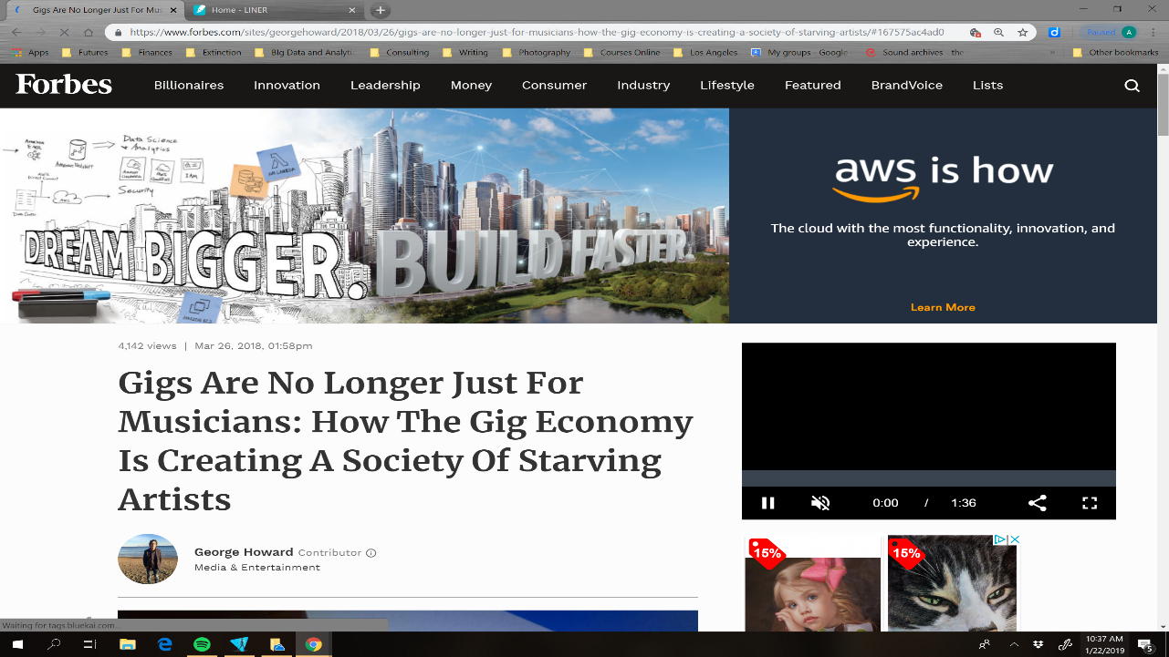

Slide 17
Platforms and Tools

Slide 18
Platform possibilities
Website Speaking Affiliates Google+ Book/Ebook
Event Workshop TV/Radio Instagram Webinar/Podcast
Joint Venture Networking LinkedIn Facebook Blog
Twitter Editorials Blog Pinterest SnapChat

Slide 19
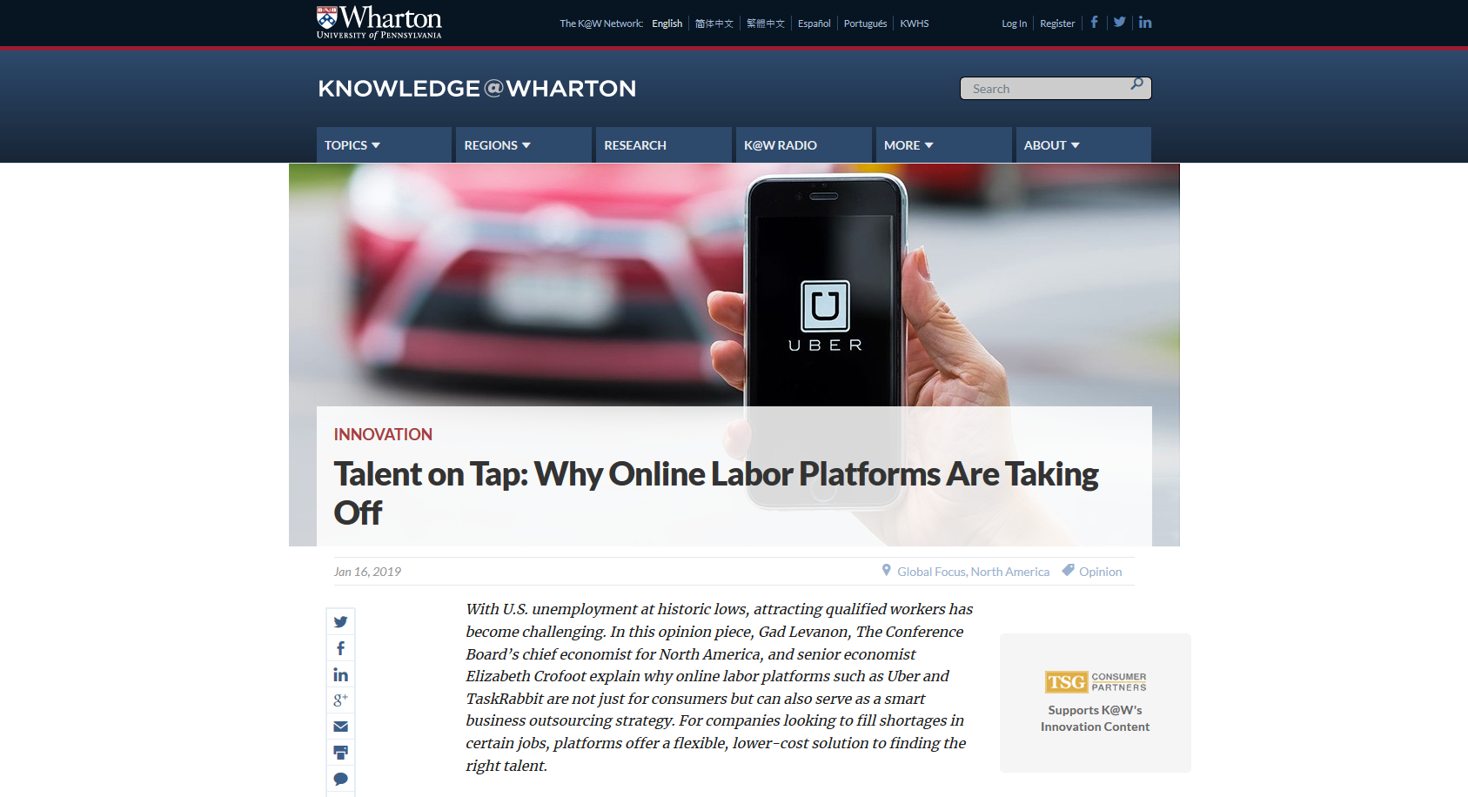

Slide 20
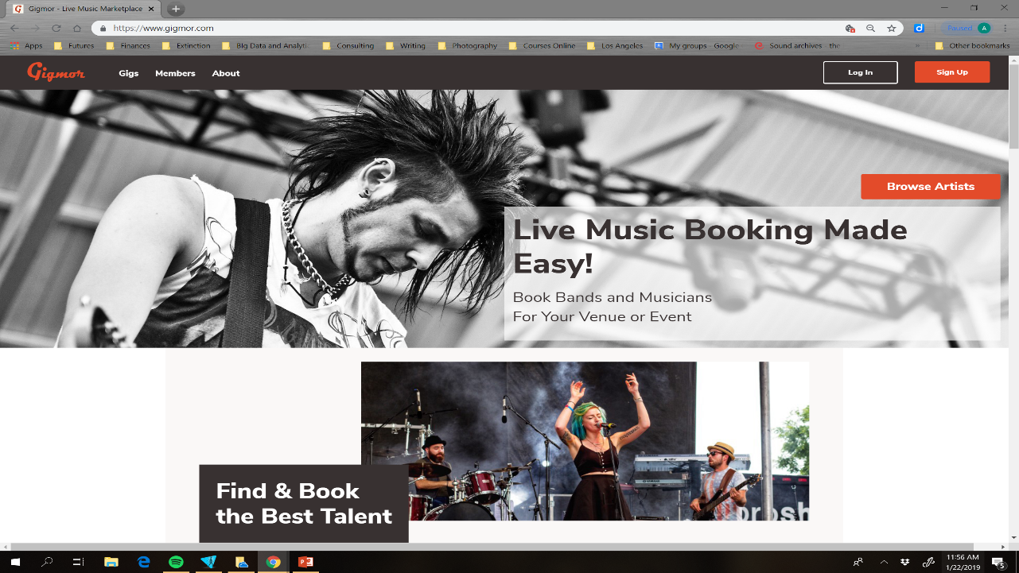

Slide 21
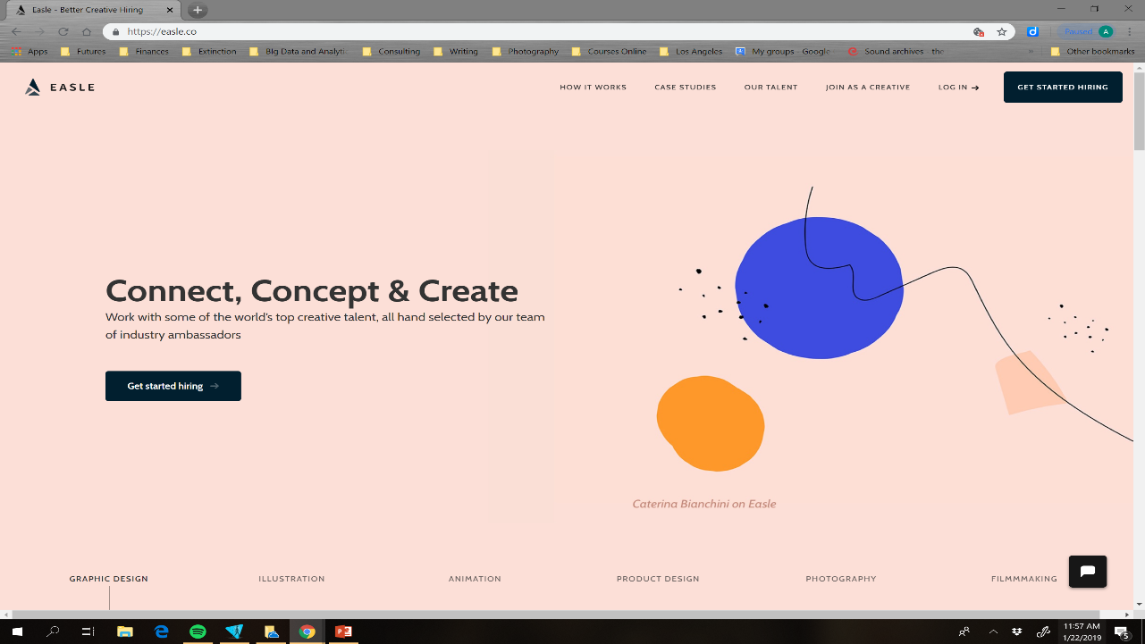

Slide 22
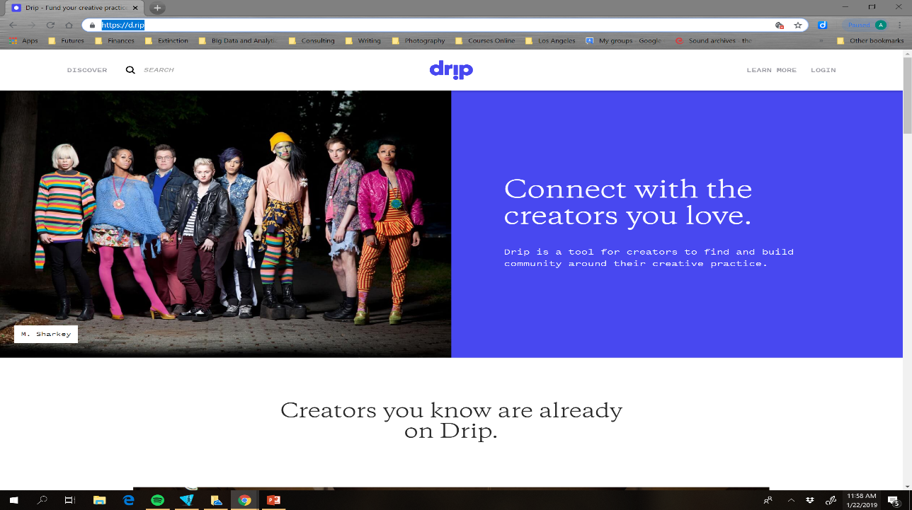

Slide 23
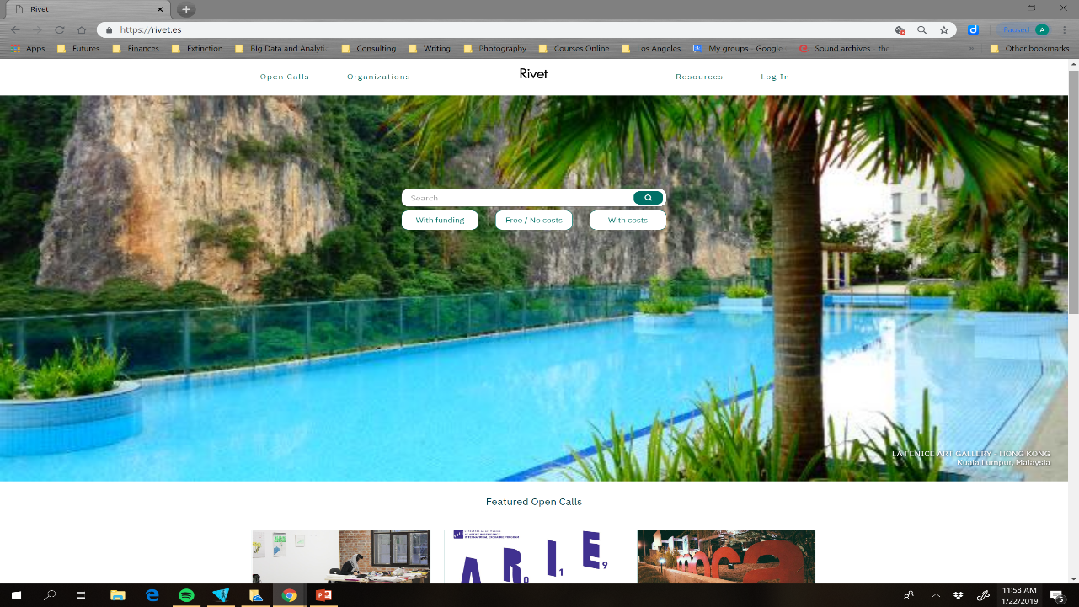

Slide 24
Some Lessons Learned

Slide 25
Do not be all things to all people

Slide 26
FOMO is destructivE

Slide 27
Do not subsidize your own career

Slide 28
Beginner’s Mind

Slide 29
Amy
2019
Public Speaking
Sectors:
Biotechnology
Art and Culture
Space
Events/
Workshop Facilitation
Twitter
LinkedIn
E-Book
Podcast

Slide 30


Slide 31
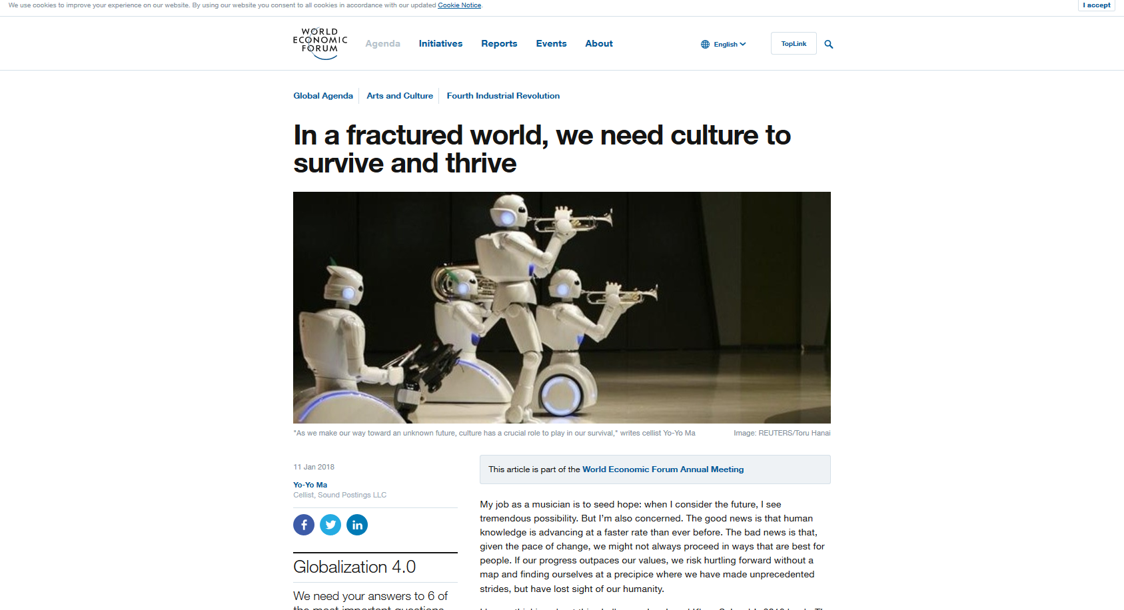

Slide 32
Thank you!
AmyFletcher@protonmail.com

Slide 33
